Slide 1

Real-Time Pakistani Sign Language (PSL) Translator
THE IDEA AND THE PROBLEM
The problem
Pakistan has over 1.5 million deaf individuals, but PSL has almost no accessible, real-time translation tools.
Bringing assistive AI to 1.5 million+ deaf individuals in Pakistan
Why past projects fell short
Most student projects only recognize static alphabet letters (A, B, C) from photos. Real sign language is fluid, dynamic body motion.
The goal
Build an assistive AI system that takes a live webcam feed of dynamic word signs and translates it instantly into spoken Urdu and text.
Webcam gesture
Urdu speech
Notes:
For my semester project, I’m building a real-time translator for Pakistani Sign Language. If you look at existing student projects, almost all of them cheat by just classifying static photos of the alphabet. Real people don’t spell out letters when they talk—they use fluid gestures. My goal over the next 12 weeks is to build a tool where someone signs naturally into a standard laptop webcam, and the system instantly speaks out the translation in Urdu.

Slide 2
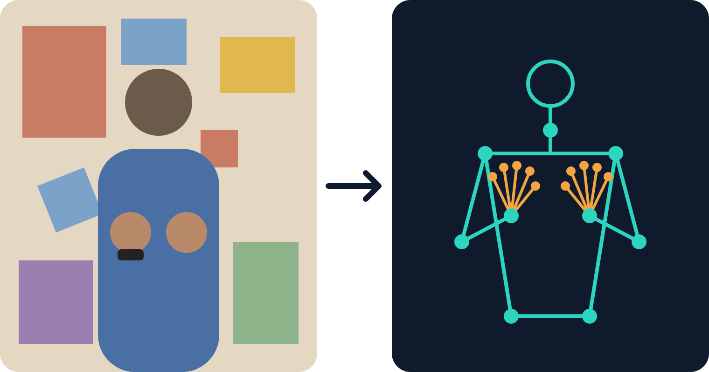
Don’t Track Pixels — Track the Skeleton
Overcoming bad lighting, messy rooms and skin tone biases
Step 1: Throw away the background
MediaPipe pulls 3D coordinates of fingers, hands and upper-body joints. It ignores wall clutter, lighting, skin color and wristwatches.
Step 2: Connect the dots
A graph neural network (ST-GCN) treats the body as joints and bones, then tracks how they move over time for velocity and motion paths.
Step 3: Instant translation
Raw webcam pixels
3D skeleton keypoints
The recognized sign comes out as Urdu text, and a local text-to-speech engine speaks it.
Notes:
The biggest technical trap in computer vision is feeding raw video pixels into a model—it breaks the second you move to a different room, change the lighting, or wear a watch. My approach completely bypasses this: I use MediaPipe to strip away the background and convert the signer into pure 3D skeletal coordinates. Then, I feed those moving joint graphs into a Spatial-Temporal Graph Neural Network to classify the motion. It’s lightweight, fast, and works in any environment.

Slide 3
12-Week Scope & Deliverables
Realistic milestones, real-world data, live demonstration
01
02
03
Data & Words
Hardware & Training
Final Live Demo
15–20 dynamic signs for essential phrases: greetings (“Assalam-o-Alaikum”), emergencies (“Help”, “Doctor”) and everyday needs (“Water”, “Thank you”).
The model is trained locally on a desktop GPU (GTX 1660 Super), so iteration stays fast.
A live in-class demonstration.
Sign a full phrase to the laptop and have it speak the Urdu translation in real time.
Edge inference runs smoothly at 30+ FPS on a MacBook Pro.
Sourced from the Deaf Reach Pakistan portal (psl.org.pk) and academic PSL datasets.
Notes:
For the next 12 weeks, I’m keeping the scope realistic. I’ll focus on 15 to 20 dynamic signs that matter in everyday life, like greetings, emergencies, and basic needs. The data comes from the Deaf Reach Pakistan portal and academic PSL datasets. I’ll train the model on my desktop GPU, a GTX 1660 Super, and run it live on my MacBook Pro at 30+ FPS. At the end, I’ll do a live demo in class: I sign a full phrase to the laptop and it speaks the Urdu translation out loud.

